Slide 1
The Many Voices Publishing Platform
Group 61 — Progress Report
Midterm Winter 2017

Slide 2
Introduction

Slide 3

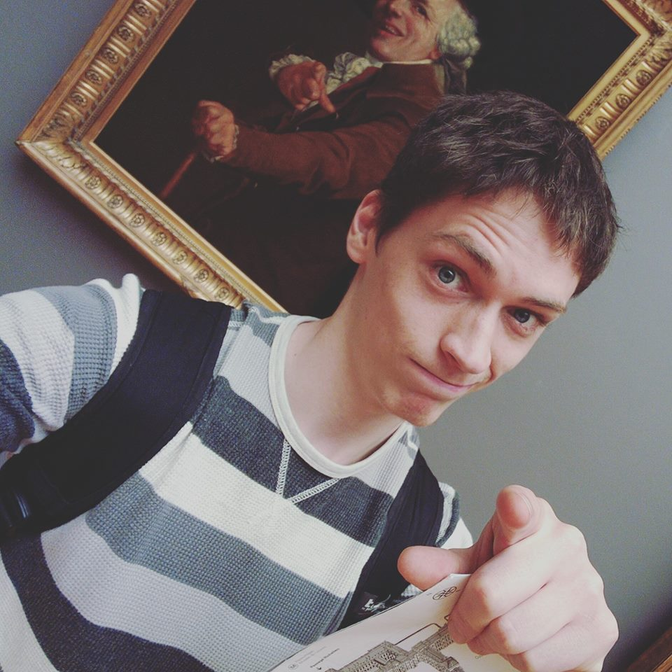
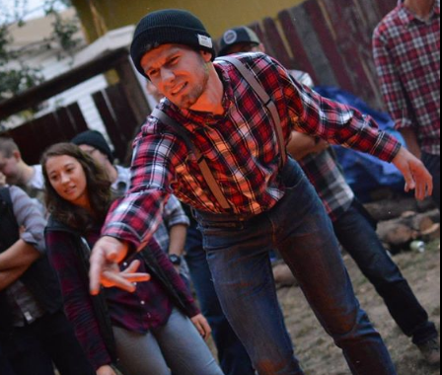
Team Remix
Steven Powers, DBA, UI/UX, Web, NWEP
Evan Tschuy, infrastructure, CoreOS
Josh Matteson, MECOP, Web

Slide 4

Our Teaching Assistant
Jon Dodge
PhD student, Computer Science
Used under fair use http://clipartsign.com/image/18721/

Slide 5
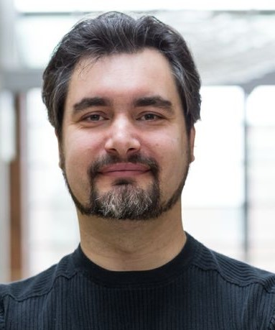
Our Client
Dr. Carlos Jensen
Assoc. Dean of Undergraduate Students
Former Director of CASS
Associate professor in the School of EECS at OSU
Areas of Interest
Teaches Social and Ethical Issues in CS

Slide 6
Our Client
Writing a textbook
Frustrated with current offerings in the textbook market
Interested in a better way to write textbooks for everyone

Slide 7
Problem Definition
Textbooks cost exorbitant amounts of money
Textbooks are often filled with poor or incorrect information
Additional resources

Slide 8
Proposed Solutions
Allow professors to create their own textbooks
Reducing costs for students
Increasing updates of information
Editing capabilities
Publishing
Searching for content

Slide 9
Definitions
Scrap - A section of a textbook, which can contain text or media
Section - An ordered collection of Scraps belonging to a chapter
Chapter - An ordered collection of Sections and Scraps

Slide 10
MVP Platform
Vision
What it does
Description & Purpose

Slide 11
Vision
An easy-to-use platform
A product that can revolutionize the textbook industry
Make it simple to have the book you want in your classroom, even if it doesn’t exist yet

Slide 12
What it does
A platform for creative textbook remixing using content from other experts in your field.
Create the perfect textbook by “remixing” exactly the texts you want
Search for new texts with easy-to-use discovery tools

Slide 13
MVP Platform
What it will look like
Why we are developing it
Who will use it
Description & Purpose

Slide 14
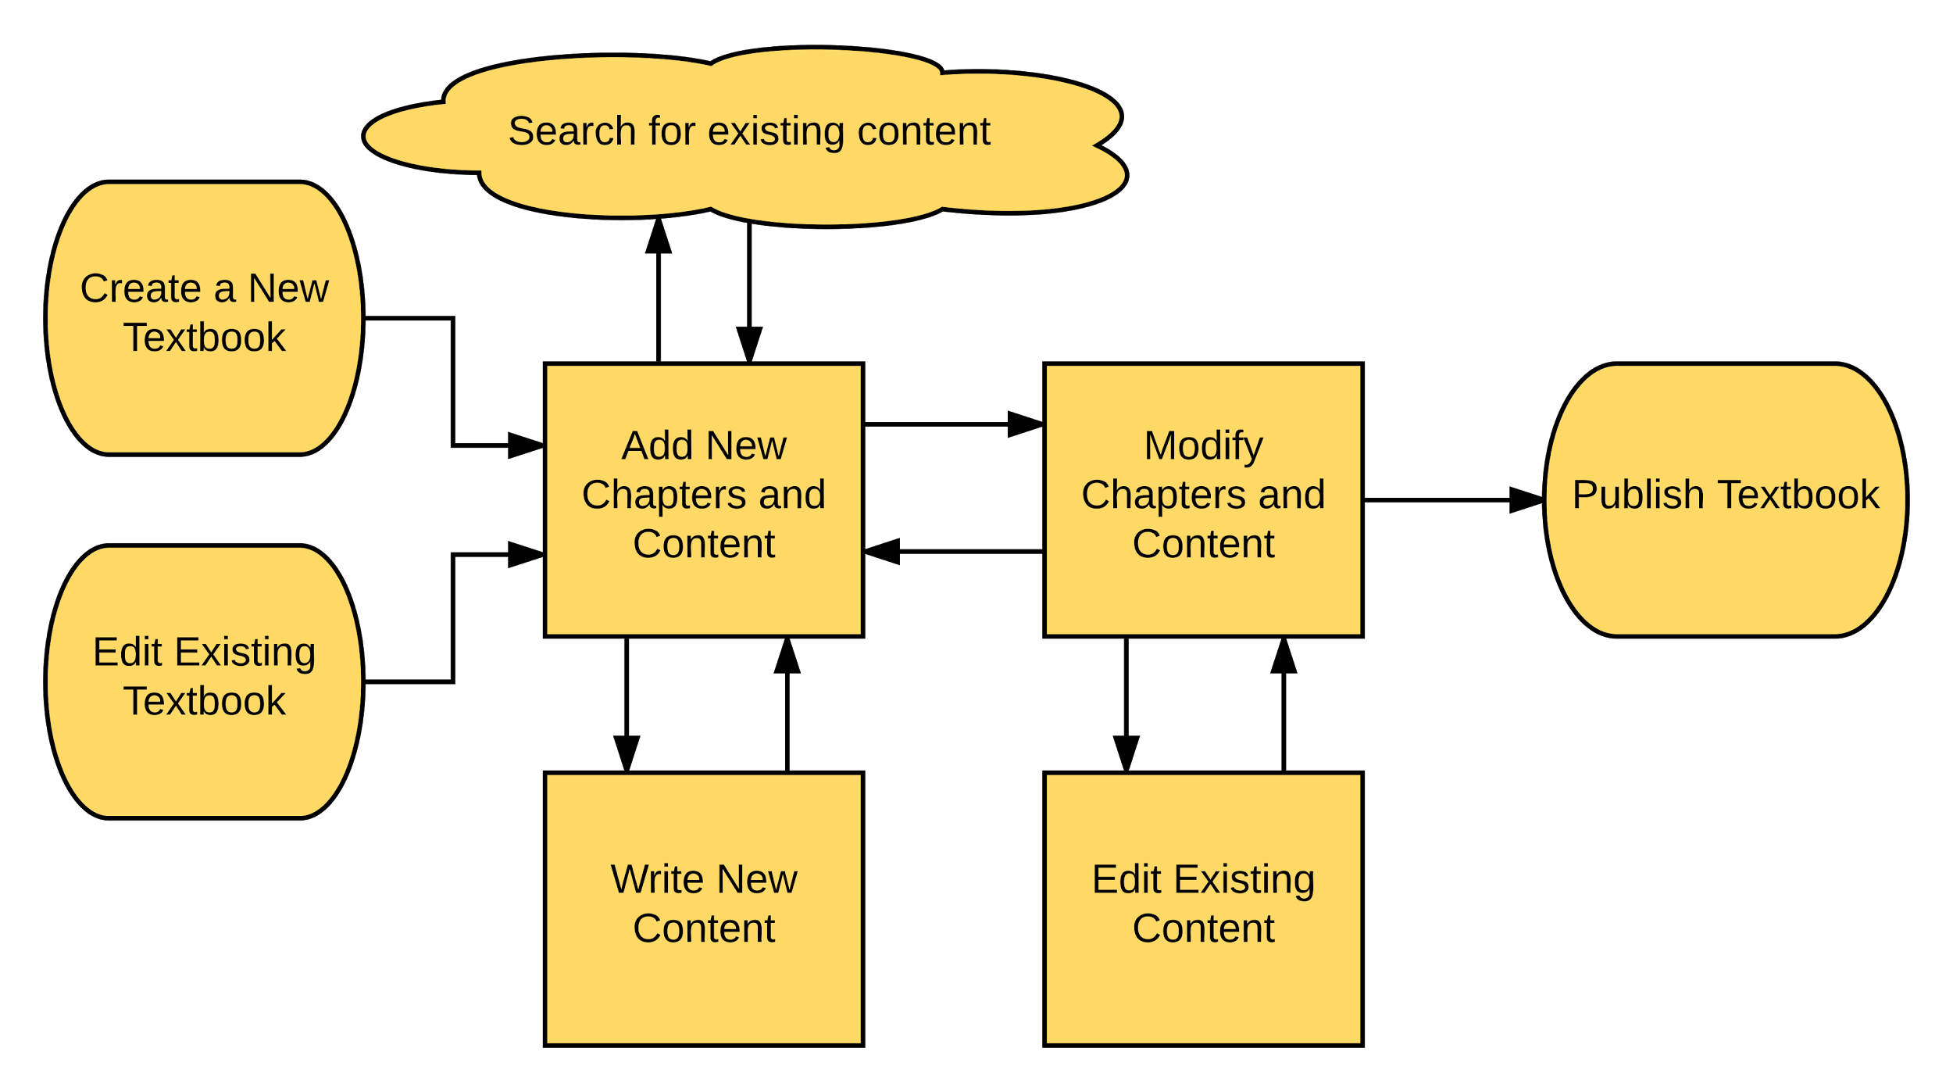
What it will look like

Slide 15
Why we are developing it
Customizing a textbook is currently not possible
Textbook writing should be like research — collaborative and open
A professor should not have to choose between having to spend years of time writing and not having the text they need to teach effectively

Slide 16
Who will use it
Professors that want to have a highly customized textbook without spending their life writing it
Those that want to “remix” existing textbooks to match their course focus area

Slide 17
MVP Platform
Frontend
Backend
Revision Control
Design

Slide 18

Frontend: Aurelia
A JavaScript framework in use since 2010
Similar to AngularJS
Compliant with W3C

Slide 19
Backend: NodeJS
Using the Express framework
NodeGit library for communication with Git

Slide 20
Git as Textbook Revision Control
Open Source
Individual scrap/section/chapter changes will be tracked on individual repositories to allow easy forking

Slide 21
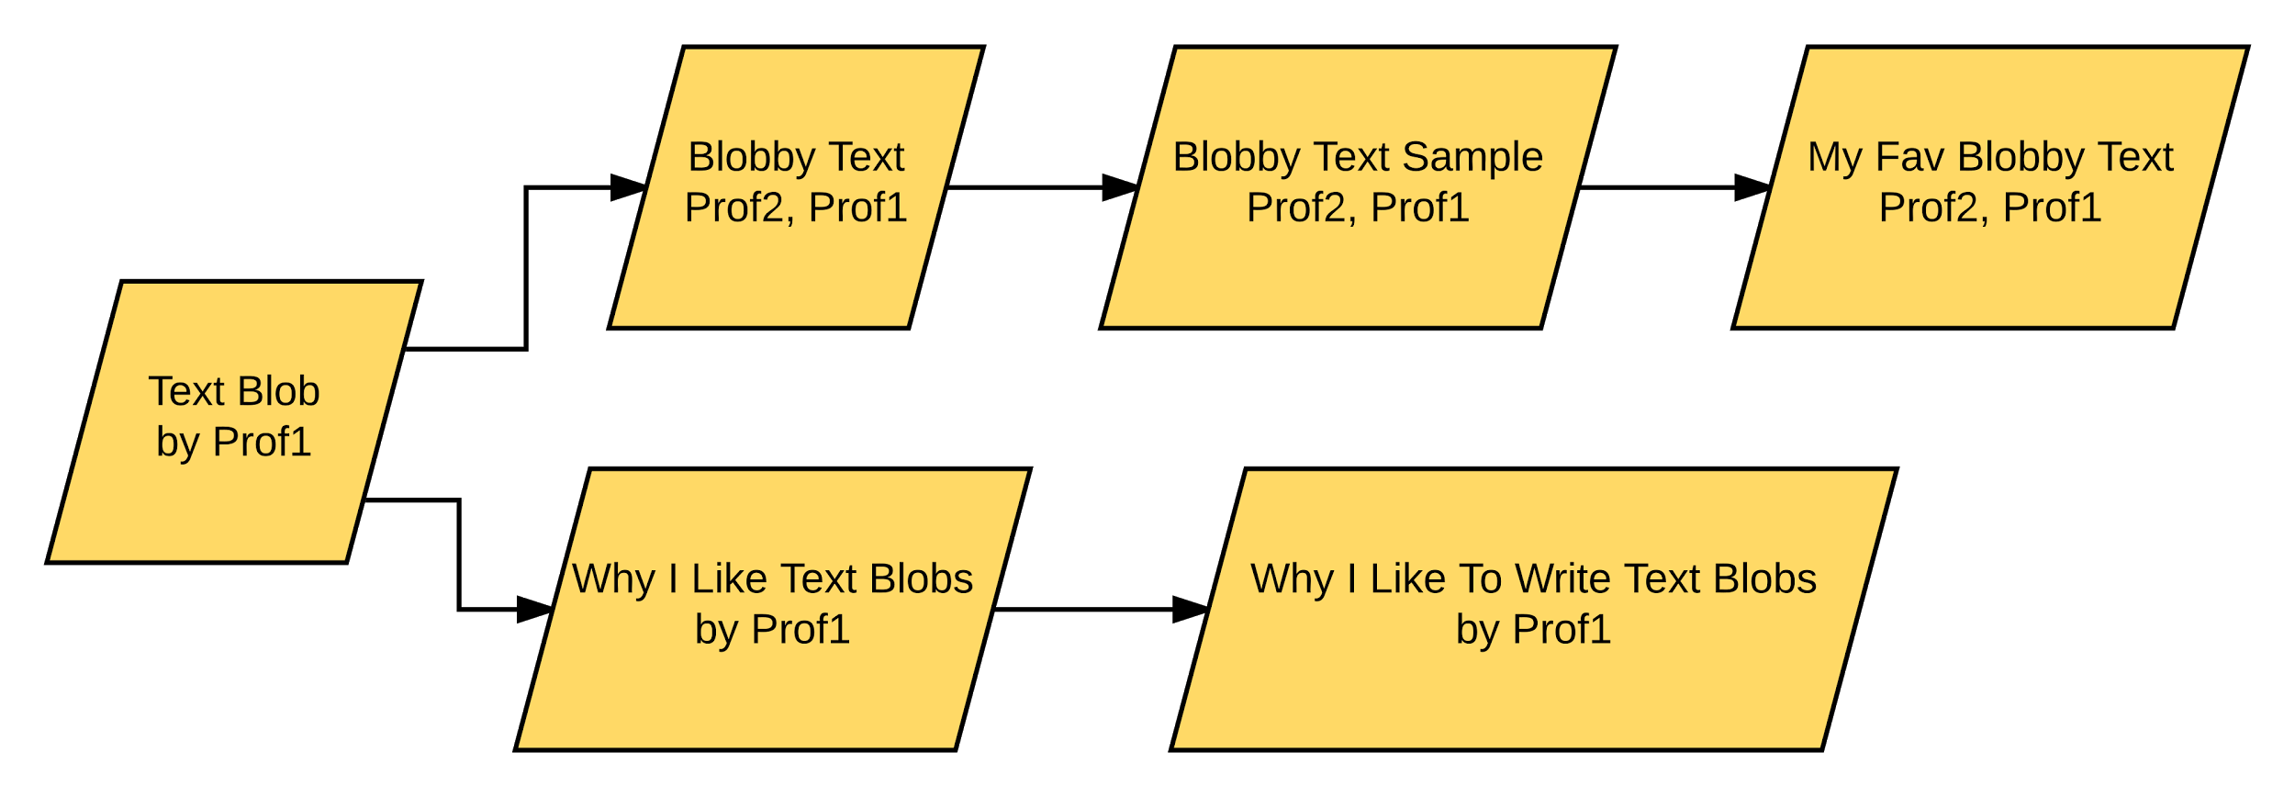
Textbook Revision Control
Textbooks can be forked and contributed to by users wanting to customize them

Slide 22
MVP Platform
Previous Impediments
Current Impediments
Reflecting on the Past For the Future

Slide 23
Previous Impediments
Client communication had been less frequent than either side wanted.
We now have regularly scheduled meetings to go over data design, interface design, and progress.

Slide 24
Previous Impediments
Time availability had been a difficult balance between our various classes
We have a two hour block set aside for working as a group every week, in addition to paired working when useful.

Slide 25
Current Impediments
Adjusting to new framework
Aurelia is a newer framework with less documentation than others such as AngularJs
JavaScript format instead of Typescript

Slide 26
Current Impediments
Layout redesign
After discussions with our client we have redesigned our layout from the ground up

Slide 27
MVP Platform
Timeframe
Frontend
Backend
Where we are

Slide 28
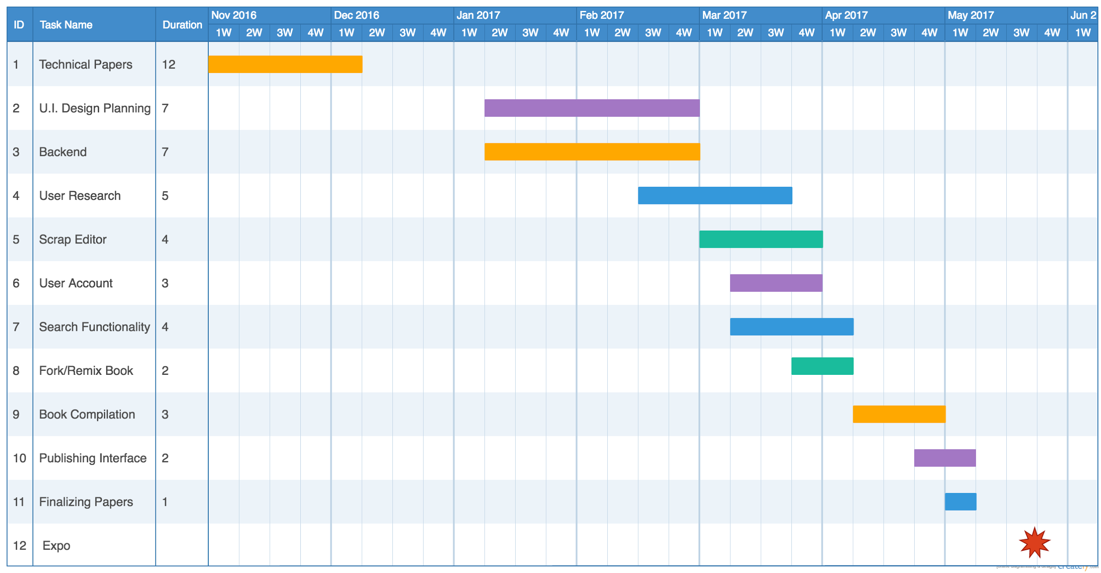
Time Frame

Slide 29
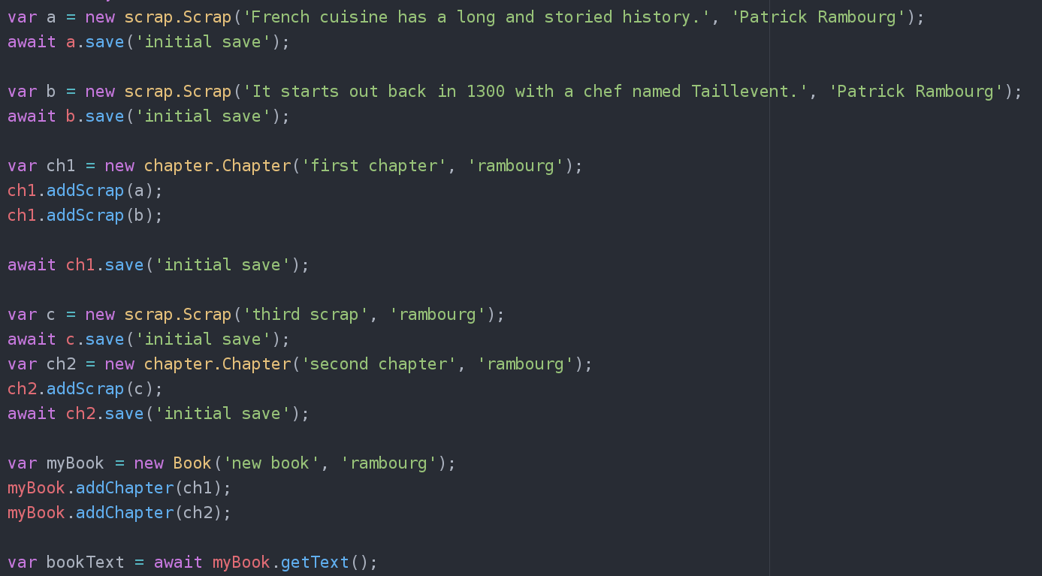
Backend - Create a library

Slide 30
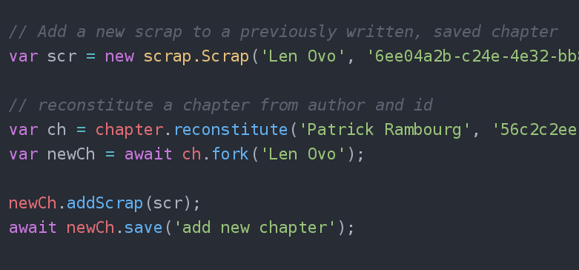
Backend - Modify existing scraps; get versions
* forking is currently not implemented

Slide 31
Backend - What’s left
Finishing the library
Forking
Get text by version (80% done)
User authentication
Search

Slide 32
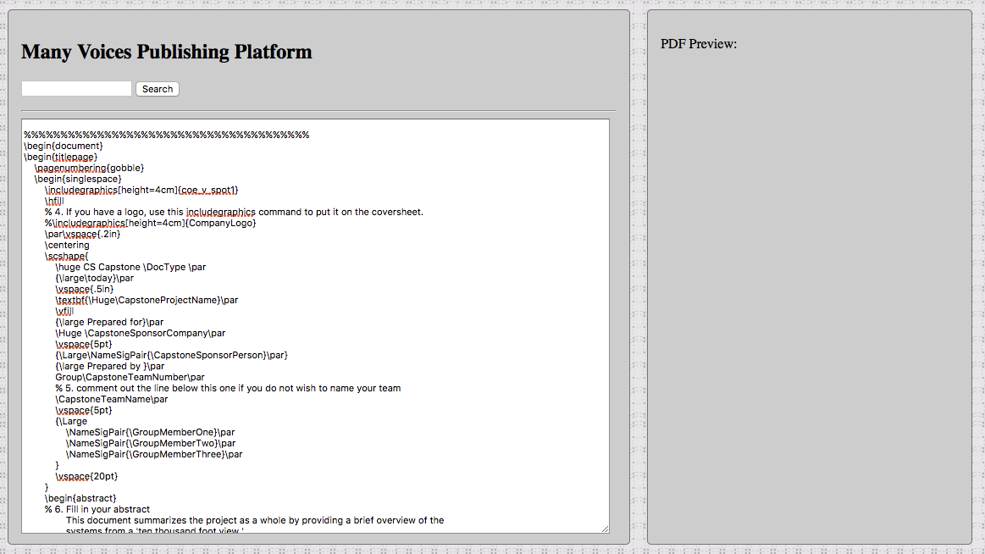
Frontend - Layout Preview

Slide 33
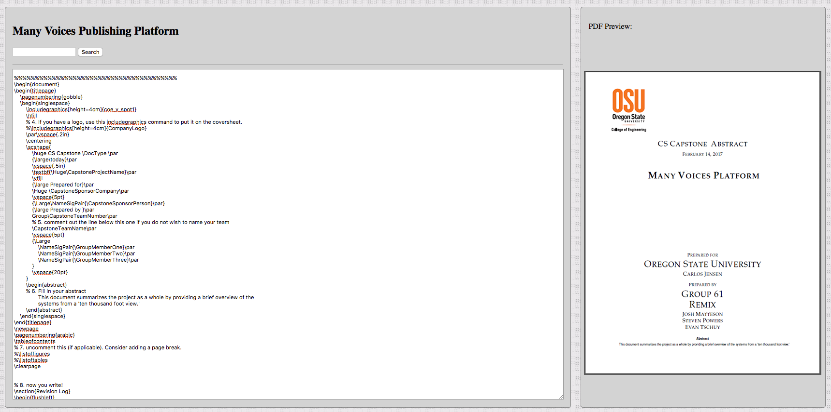
Frontend - Hypothetical Combined View

Slide 34
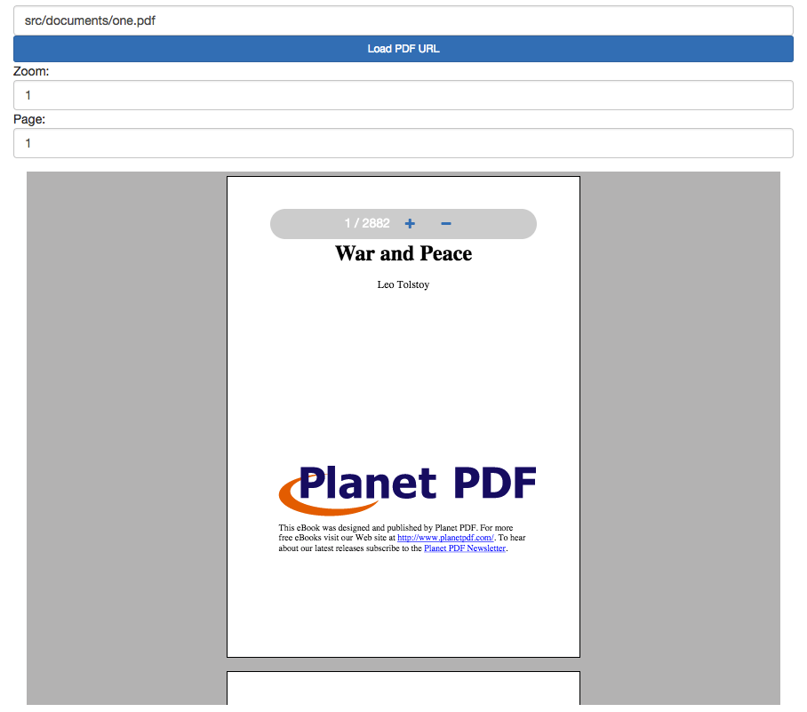
Frontend - PDF Viewer Preview

Slide 35
Frontend - What’s left
Integration of Pdf Viewer and Application
Finalizing layout design
Working scrap editor
Book/chapter/scrap view
Tabbed layout
User Testing and Feedback Integration

Slide 36
Conclusion

